Slide 1
Arundo Donax
The Invasive Plant in our Backyard

Slide 2
Land and Water Acknowledgement
Water in the Sonoran Desert is of great ecological and spiritual significance to be protected, cherished, and celebrated.
The Santa Cruz watershed is part of the ancestral lands of the Hohokam and Sobaipuri, as well as the Pascua Yaqui and Tohono O’odham whose relationship with the watershed continues today.
We share our gratitude for their wisdom and stewardship of the land and water.

Slide 3
Watershed Management Group
WMG Mission Statement
Current Projects
Arundo Removal Workshops (Every Saturday)
Beaver Surveys (Annual)
River Trash Cleanups (Monthly)
Rainwater/Greywater Harvesting Classes (Monthly)
Notes:
WMG Mission Statement = “Watershed Management Group develops community-based solutions to ensure the long-term prosperity of people and health of the environment. We provide people with the knowledge, skills, and resources for sustainable livelihoods”

Slide 4
Notes:
This is the Tanque Verde Creek and as you can see there’s a lot of green, water that flows for most of the year (last year it was 288 days of continuous flow) and tons of wildlife and plant life. In fact, I’ve seen bobcats, hawks, and snakes on the workshops. So we’re working really hard to preserve this and other natural resources around Tucson. But our mission is not just about preservation, in our 50-year plan, we want to see Tucson become more and more integrated with its natural resources and to eventually create a place where the relationship between communities and environment creates a mutually beneficial relationship rather than the one-sided one we see today.

Slide 5
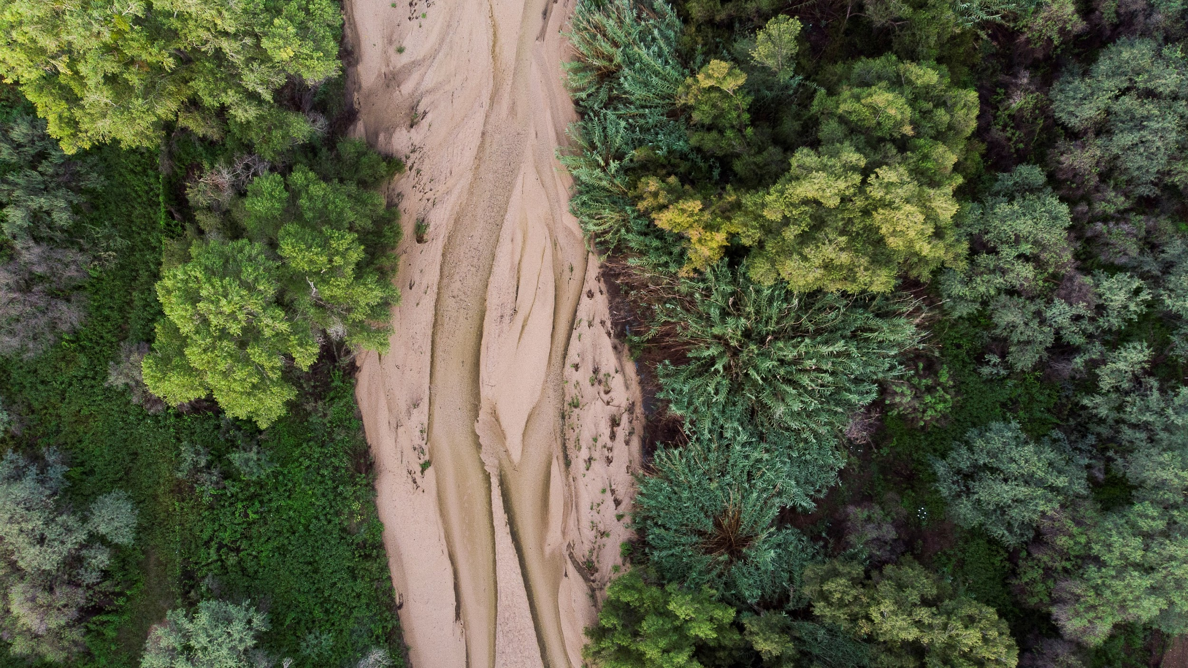
Notes:
These are some more pictures of the Tanque Verde specifically and what I’m mainly going to talk to you all about today are invasive species within this area and how water can interact with them and the land. So here we can see Arundo in these light-ish green and spiky patches and you can see that a lot of it concentrates on the shorelines of the riverbed. This is mainly because of the amount of water Arundo takes up and how it interacts with the land to change the course of the river.
Ask audience if they can label some of the plants in this picture of the Tanque Verde
(Spiky = Arundo, Green/Yellow = Cottonwood, light green on sides = Mesquite)

Slide 6
Notes:
Here, we’re on the ground level of the Tanque Verde Creek. And we can see a variety of plants around us. Can anyone here tell me which is Arundo?
We have patches of it all around, taking lots and lots of water from the native plants and even growing so fast that they choke out the native plants. Arundo also takes groundwater and evapotranspirates it into the atmosphere. Now, all plants do this to some degree, but Arundo does it at a much higher rate than native plants. Because of this, vast clumps of Arundo can actually lower the water table and make it harder for anything else to survive. Furthermore, when it dies and dries up, it is a huge fire hazard because these massive clumps are great fuel for a fire.

Slide 7
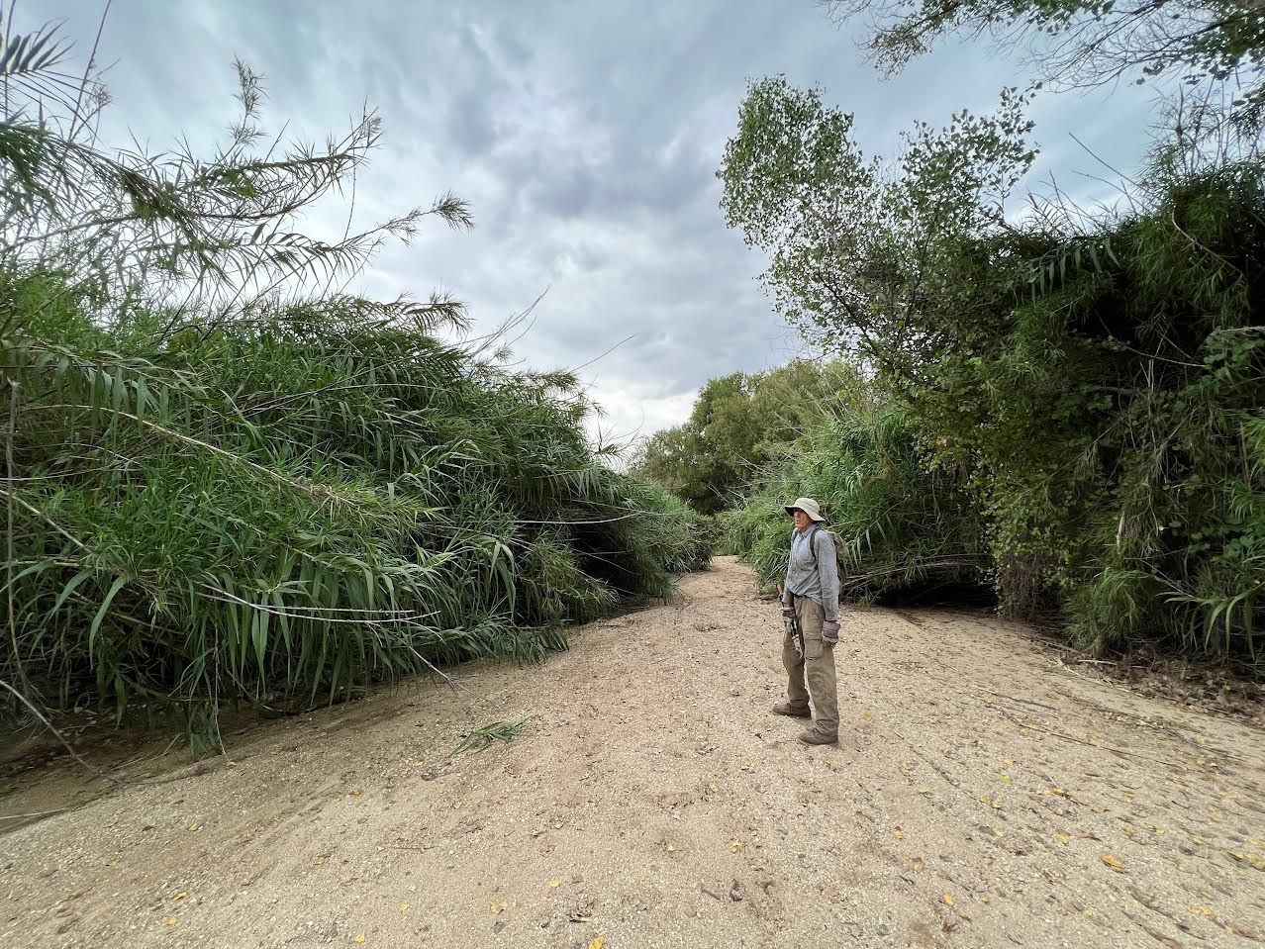
Context
Arundo Donax
20 ft Tall
Looks Like Bamboo
Long, Bladed, Leaves
Drinks 3-4 times more water than Native Plants
Pulling water from ground and evapotranspirating it into the air
Notes:
Originally from the Mediterranean and Middle East, Arundo Donax, also known as giant cane, is an invasive species in the United States that likes to infect and destroy riparian environments. It can grow to 20 feet tall and is identifiable by bamboo looking stalks along with long, bladed, leaves. Although Arundo has seeds, they’re actually mostly sterile. Instead, it spread rhizomally, meaning that patches of its roots that get broken off can stick into the ground and sprout a whole new plant, kind of like when you propagate a cool plant in your backyard or garden.

Slide 8
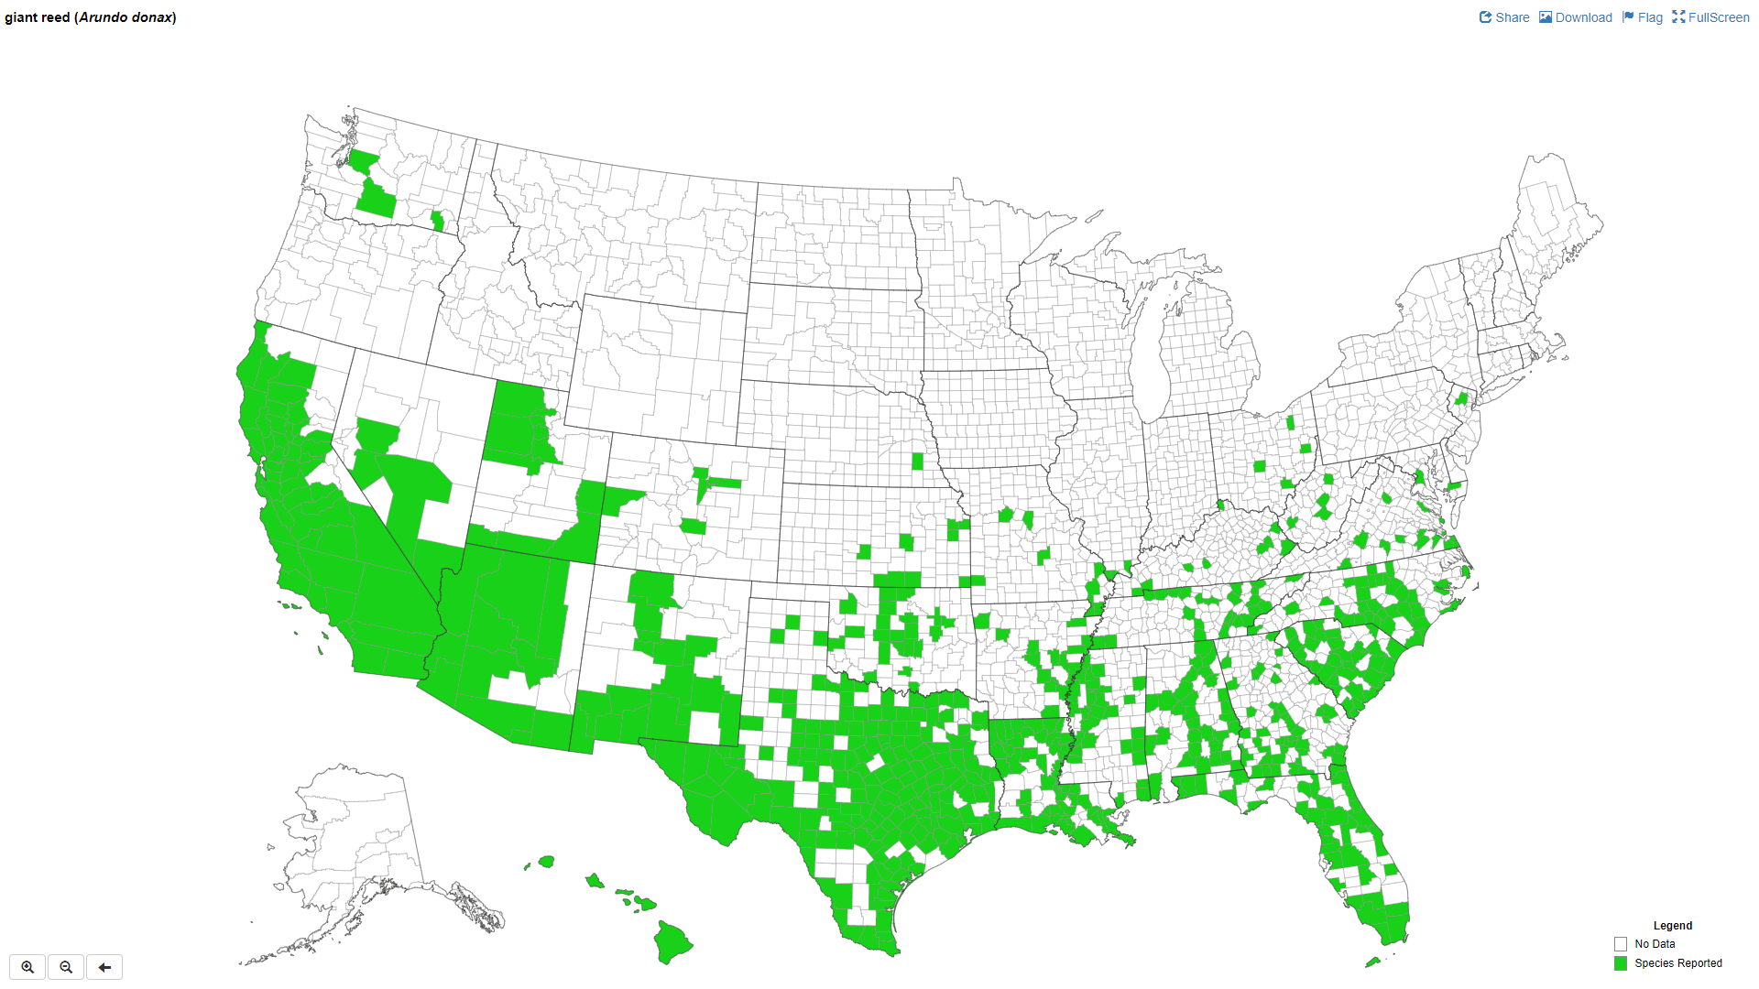
Notes:
(Map is from Plant Atlas source)
As we can see, Arundo is really prominent in the southern US and especially concentrated in the Southwest. In Arizona specifically, it has been reported in all but four counties and is labeled as one of the world’s most dangerous invasive species. I feel that this map really placed things into perspective for me and really showed me that this isn’t just a Tucson problem, it’s something we need to challenge on a national level.
Also, when we mentioned that our goal was complete eradication in 3-5 years, that’s just in the Tanque Verde, which is a small part of the Pima county ‘square’

Slide 9
Workshops
What we can do to help

Slide 10
What Have We Already Done?
50 tons of invasive Arundo was removed last season by River Run Network volunteers.
WMG’s goal: complete eradication in Tanque Verde within 3-5 years.

Slide 11
Workshop Details
Tanque Verde Rd and Wentworth Rd
~30 min Drive from Campus
Every Saturday 8:30am-12:30pm
Bring a friend!
Time Commitment & Flexibility

Slide 12
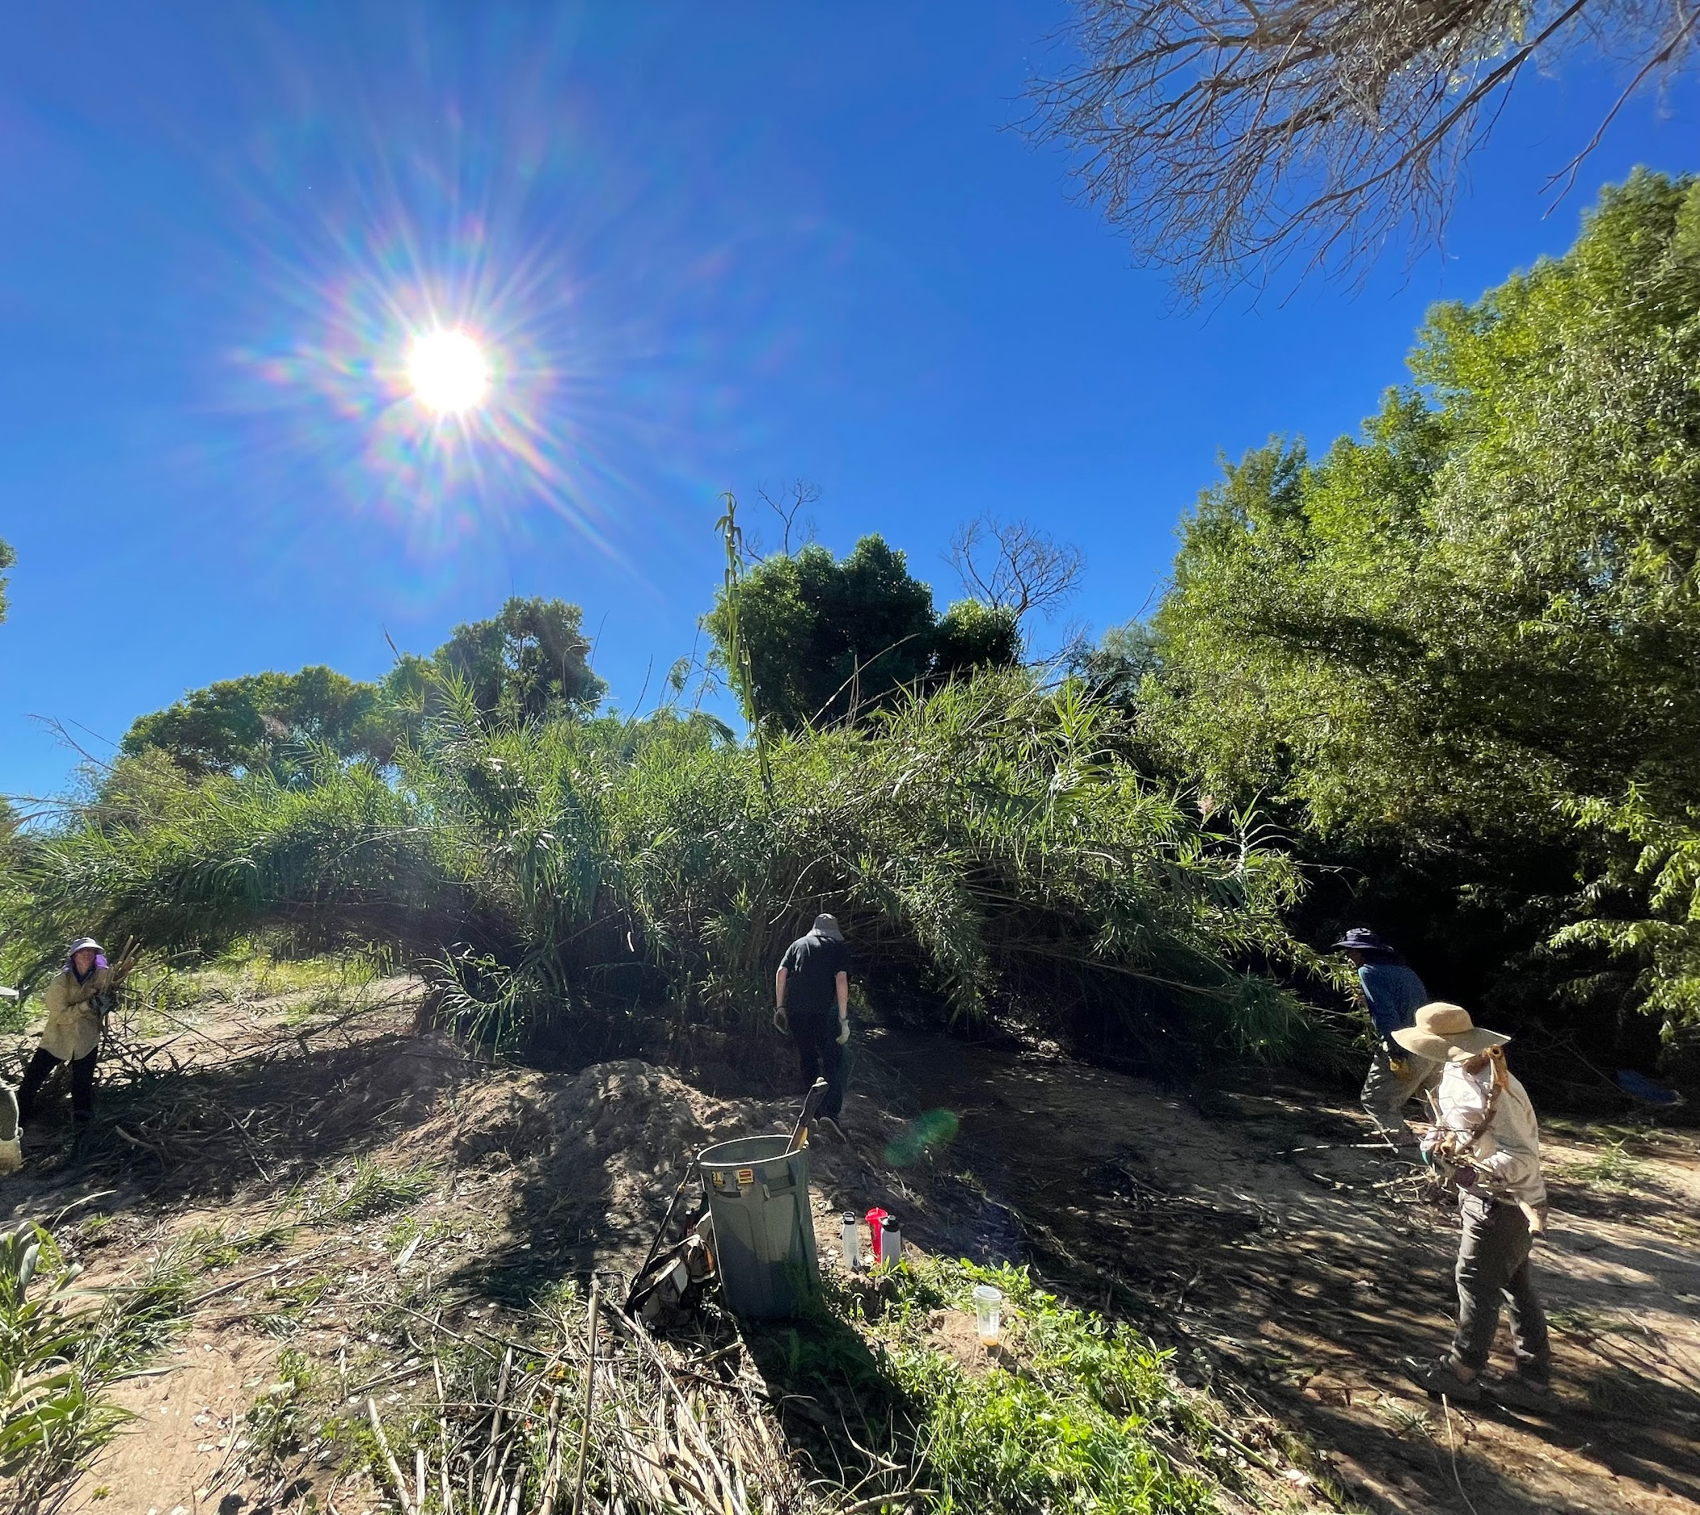
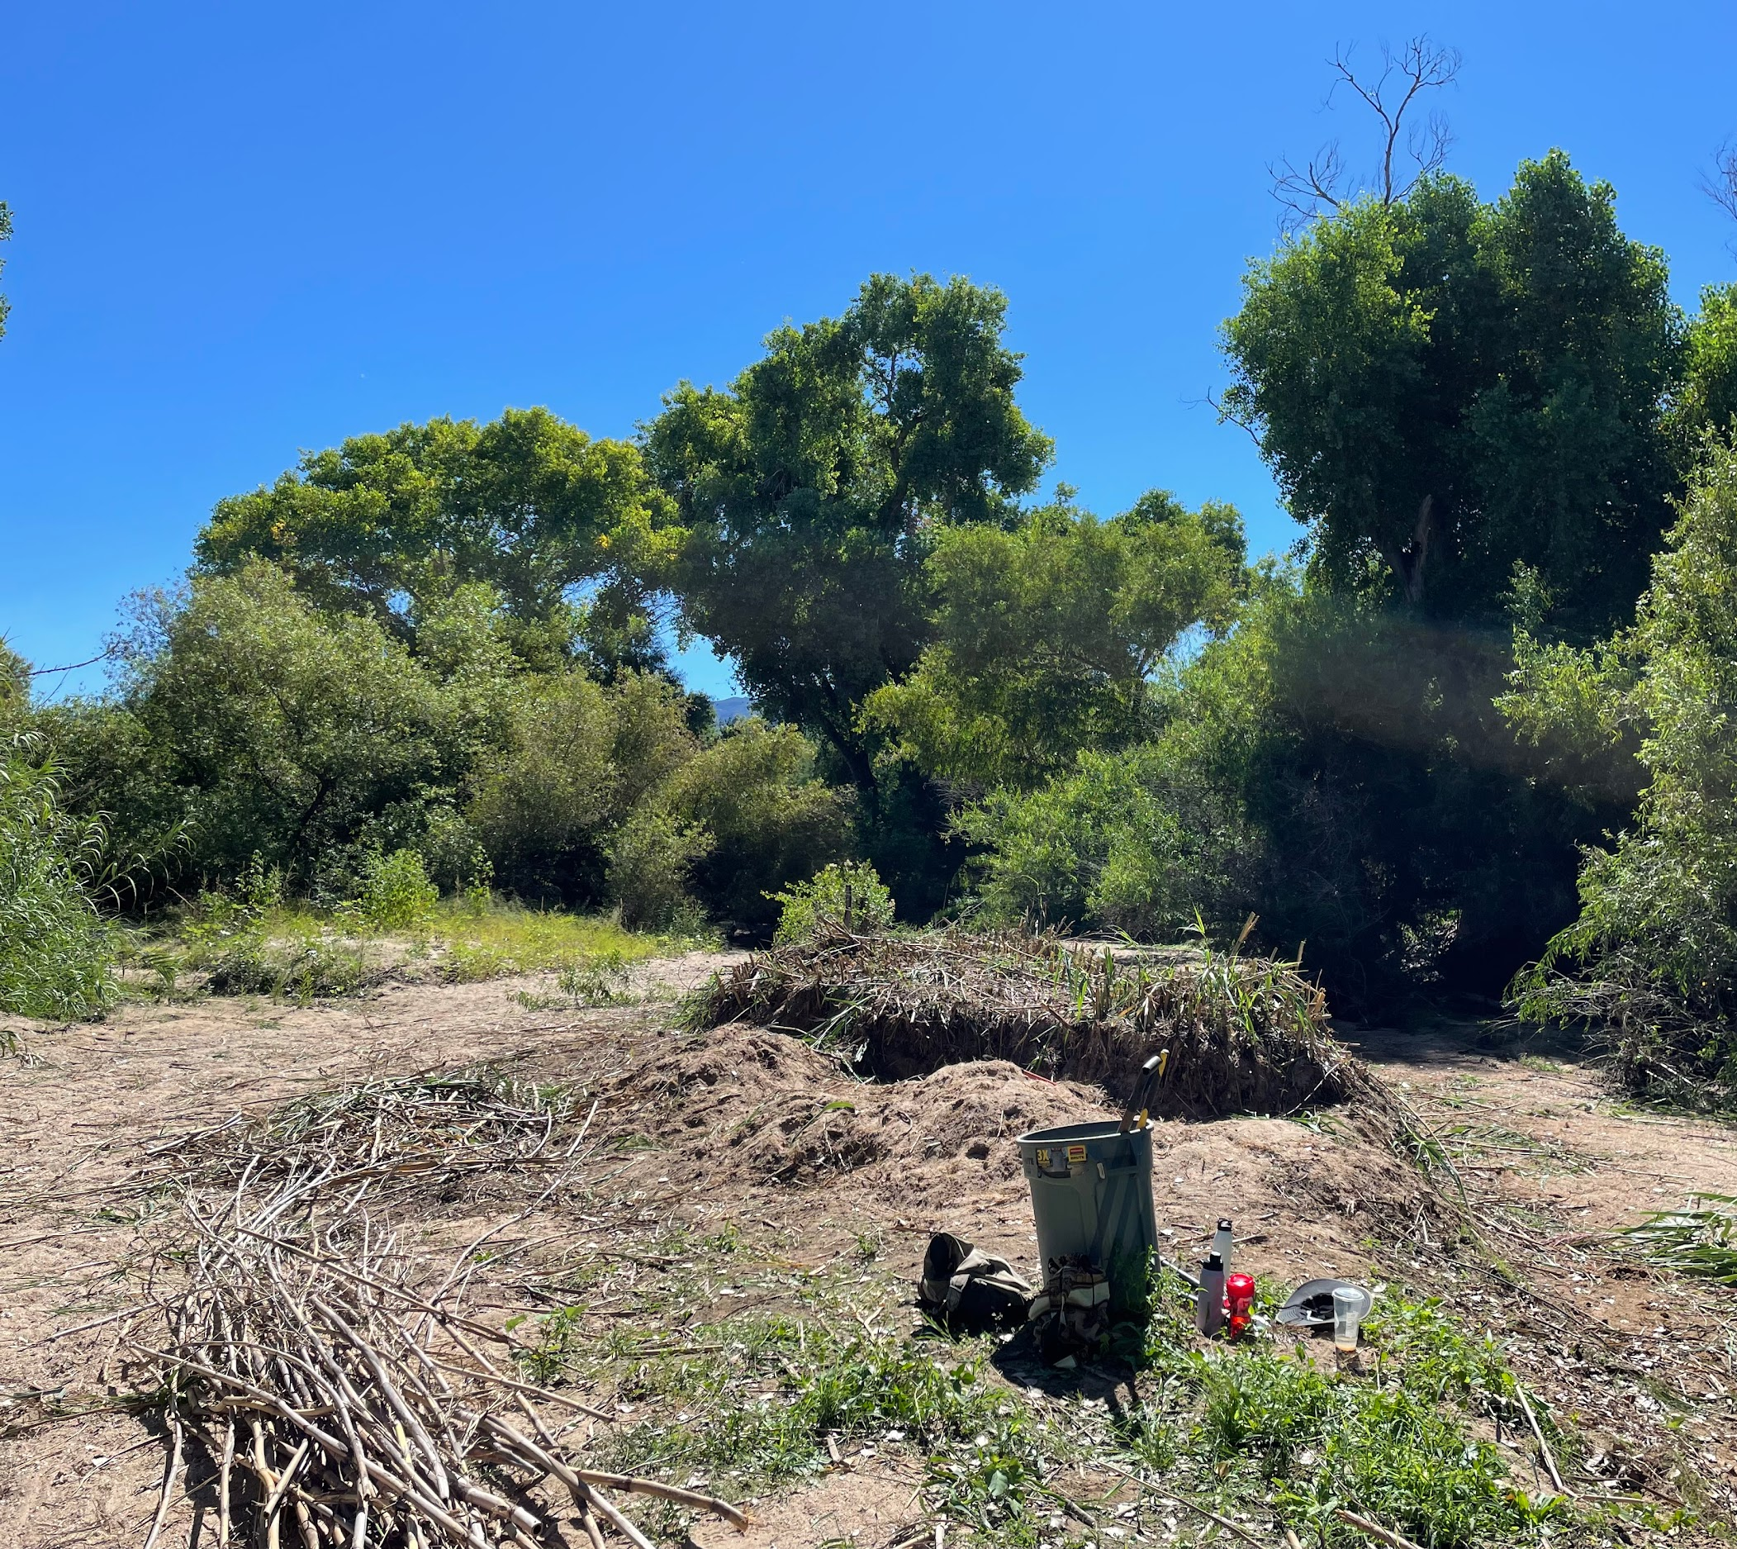
Before vs After
Notes:
This is from a workshop we did in September, we took down the whole stand of Arundo! What we do with the dead Arundo is we send it to become mulch but recently we partnered with a local farmer who fed it to her goats. Unfortunately, Arundo provides little nutritional value and doesn’t really do much to provide ecological value as well.

Slide 13
Why You Should Go
Hole-Punch Card!
T-shirt
Beaver Hat
Exclusive Outdoor Trip
Volunteer Hours
Helping restore groundwater!
Fighting Climate Change!
Notes:
exclusive trip = Next spring, somewhere with flow, day trip/hike 2-3 hours in Tucson area (likely Rillito/Sabino area)

Slide 14
Questions?
Notes:
Erosion and Animal Habitat
Although Arundo does provide protection against erosion with its extensive root system, there are other native plants that do this better (find and list these)
In fact, Arundo actually creates a buildup of soil in one area that artificially changes the course of creeks and rivers
This can create sediment build up that elevates the ground and makes it harder for water to infiltrate to native plants, some of which have shallow roots
Arudo does provide habitat for many species of wildlife, but this is mainly because there’s just so much of it. Native flora would provide much better habitats to native fauna in locations where Arundo is overgrown. Most Native wildlife doesn’t even use/eat Arundo at all, it has very little wildlife value
Talk about erosion benefits of removing arundo, the tree of the left on this picture is a good example of the water table being lowered by Arundo and then new smol plants growing afterwards

Slide 15
Sources
(https://www.invasiveplantatlas.org/subject.html?sub=3009)
https://www.cabi.org/isc/datasheet/1940
https://watershedmg.org/
James Washburne, hydrologist, 10+ years removing Arundo

