Slide 1
Increased Signs at Cooper Center to Better Serve Visual Learners
Bella Howe

Slide 2
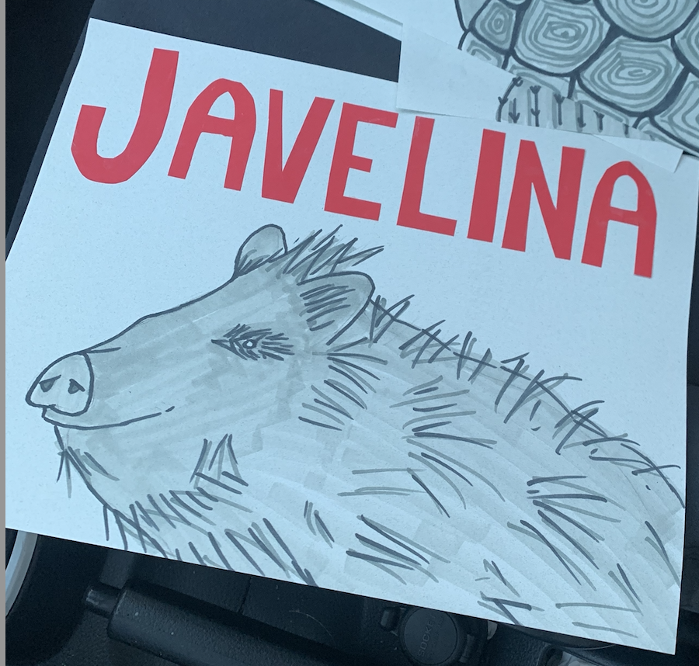

Slide 4
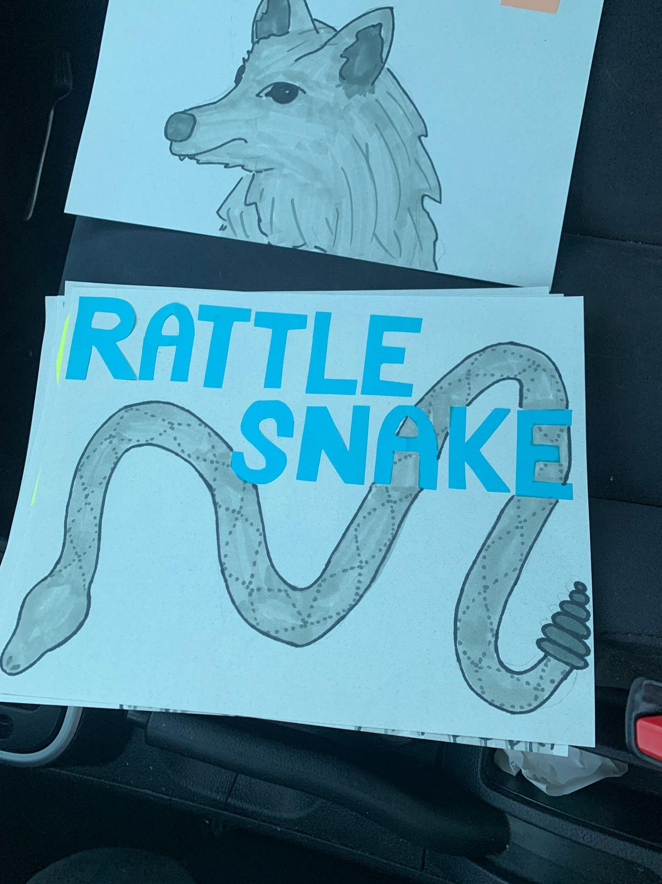

Slide 6
